Slide 1
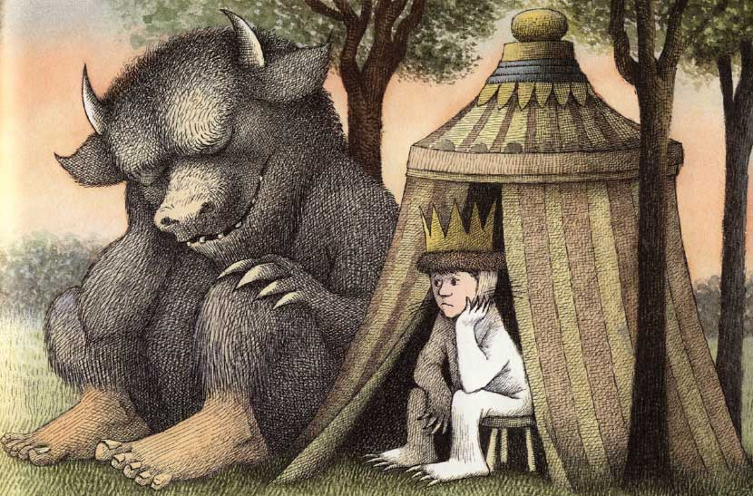

Slingsby CP School
Class 1 Curriculum Newsletter
Autumn 1
DT (Expressive art and design)
Year 1: Stable structures
EYFS: Junk modelling
Literacy (Comprehension, word reading and writing)
Key Texts: Where the Wild Things Are; Anansi the Spider
Story Dough/Drawing Club: The Colour Monster; The Friendship Bench; Super Duper You!; Astro Girl; Elmer
Year 1: our own “wild thing” narrative; booklets about spiders.
EYFS: handling books; my favourite; joining in with stories, songs and rhymes; my name
P.E (Gross and fine motor skills)
Year 1:Locomotion (running)
EYFS: Moving (running); dressing myself; lines and circles, holding a pencil.
Music
Year 1: Pulse
EYFS: Sound
R.E (People, Culture and Communities)
Who is a Christian and what do they believe?
Wild Things
Science (The Natural World)
Seasonal change
Year 1: What is the weather today? How does the weather change? How can we observe the weather?
EYFS: What is the weather today?
Computing
Year 1:Improving mouse skills
PSHE(incorporating RSE)(PSED)
Year 1:Introduction to PSHE
EYFS: Pantosaurus!
History (Past and Present)
Year 1: How am I making history?
EYFS: How have I changed?
Maths (number and numerical patterns)
Year 1: Place value within 10; addition and subtraction within 10.
EYFS: Match, sort and compare, measure and patterns, compare, represent and subitise number 1-3.
Reminders•Hello everyone. Please can reading books and records be brought into school daily. Books will be changed weekly after the children have read their book three times in school. We encourage the children to re-read books to support their fluency and confidence in word reading as well as their comprehension skills. • PE sessions for Class 1 will take place every Thursday. Our Reception children will only change their shoes for P.E sessions initially. Otherwise, children need a pair of trainers, socks, warm trousers and a jumper, as where possible PE will be outside. Class dojos will be awarded to the children for such things as kindness, working hard and being a good friend. Don’t forget to read the Class 1 Blog published every week on Class Dojo to keep up to date on the children’s learning each week. Please do not hesitate to ask if you have any questions at all, either at the door or by email admin@slingsby.n-yorks.sch.uk. Thank you.

