Slide 1
Lesson 3: Drawing lines
Save a copy
Programming – Events and actions in programs
Notes:
Last updated: 01-07-20
This resource is available online at ncce.io/pg3b-3-s. Resources are updated regularly — please check that you are using the latest version.
This resource is licensed under the Open Government Licence, version 3. For more information on this licence, see ncce.io/ogl.

Slide 2
Lesson 3: Drawing lines
Objectives
To adapt a program to a new context
I can use a programming extension
I can consider the real world when making design choices
I can choose blocks to set up my program

Slide 3
Describe this project
Introduction
In as much detail as you can, describe what happens in this Scratch project.
ncce.io/pg3b-3-a0-ca
Think about:
The sprite
The events
The actions
Work with a partner and write your description.

Slide 4
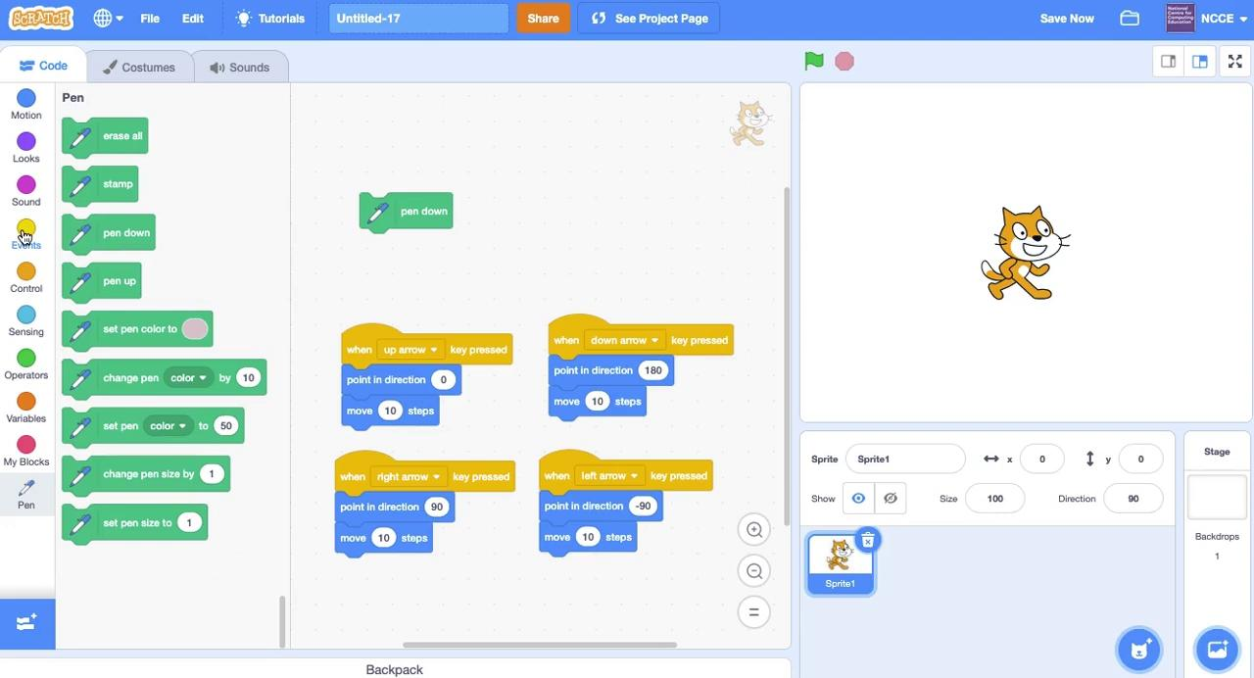
Adding Scratch extension blocks
Activity 1
Notes:
Video from Scratch 3.0

Slide 5
Create your own drawing program
Activity 1
Choose the Pencil sprite
Move it in four directions (you learned how to do this in the last lesson)
Go to the Pen extension blocks (click on to add the extension) and use:
Note: pen down enables you to draw lines. pen up stops the sprite drawing.
Notes:
Screenshots from Scratch 3.0

Slide 6
How could you improve the appearance of your project?
Activity 2
Can you make the pencil draw from the tip?
Notes:
Screenshot from Scratch project at ncce.io/pg3b-3-a0-ca

Slide 7
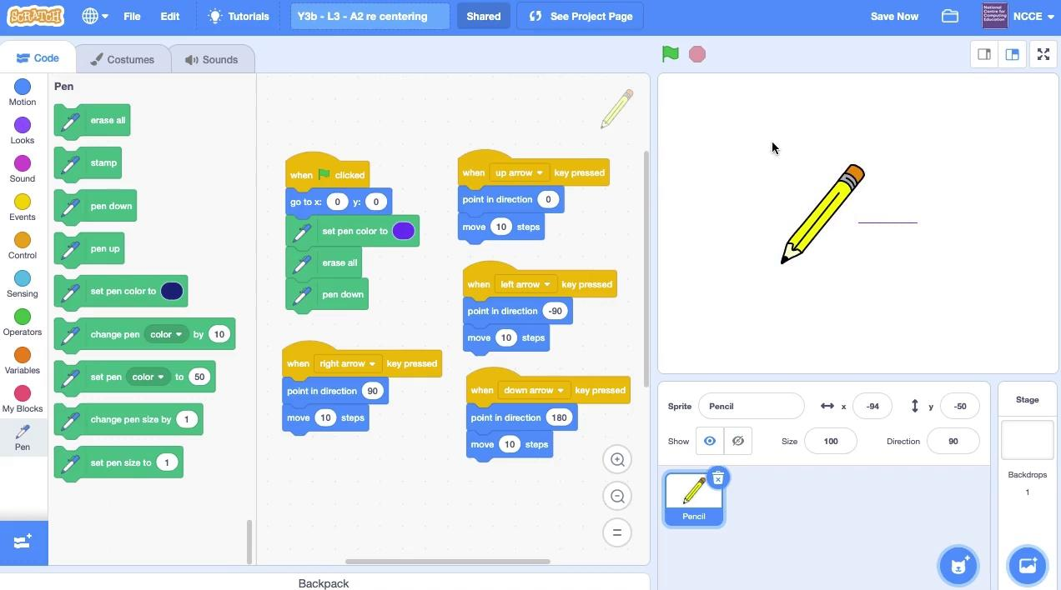
Changing the centre of a sprite
Activity 2
Click on the Costumes tab
Click and drag a box to select the whole sprite
Move the sprite so that the point of the pencil is on the cross
Run your project again
Can you recentre the sprite in your project?
Notes:
Video from Scratch project at ncce.io/pg3b-3-a0-ca

Slide 8
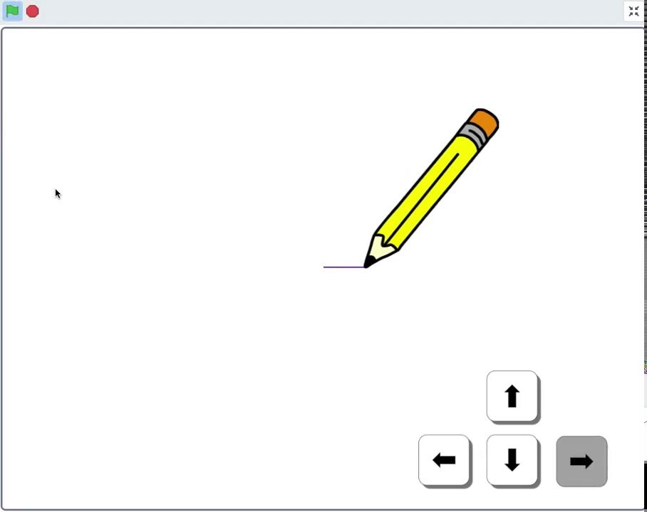
Setting up a project
Activity 3
Your project should start in the same way every time it is run.
Blocks can be added to a project to make sure this happens.
What happens when the green flag is clicked in this project?
Use your worksheet to make notes.
Notes:
Video from Scratch project at ncce.io/pg3b-3-a0-ca

Slide 9
Planning the setup of your project
Activity 3
Use your worksheet to help include setup in your project.
These blocks might be useful.
Remember to include an Events block.
Notes:
Screenshots from Scratch 3.0

Slide 10
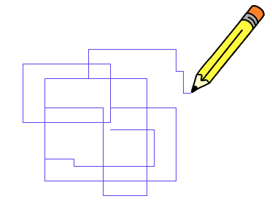
Why is setup important?
Plenary
Think, pair, share.
Notes:
Screenshot from Scratch 3.0

Slide 11
Assessment
How confident are you? (1–3)
I can use a Scratch extension
I can consider the real world when making design choices
I can choose blocks to set up my program
3 – Very confident
2 – Unsure
1 – Not confident
Notes:
Thumb: https://pixabay.com/vectors/thumb-up-hand-like-confirm-go-top-307176

Slide 12
Next lesson
Summary
In this lesson, you...
Learned how to draw lines with a sprite using an extension block, recentred a sprite to improve the appearance of your project, and learned how to set up your project so that it starts in the same way each time it is run
Next lesson, you will...
Create new effects with your pencil, and design your own drawing program

