Slide 1
Lesson 3: Patterns and repeats
Save a copy
Programming – Repetition in shapes
Notes:
Last updated: 01-07-20
This resource is available online at ncce.io/pg4a-3-s. Resources are updated regularly — please check that you are using the latest version.
This resource is licensed under the Open Government Licence, version 3. For more information on this licence, see ncce.io/ogl.

Slide 2
Lesson 3: Patterns and repeats
Objectives
To explain what ‘repeat’ means
I can identify everyday tasks that include repetition as part of a sequence
I can identify patterns in a sequence
I can use a count-controlled loop to produce a given outcome

Slide 3
What comes next in this pattern?
Introduction
Draw the next flag in the pattern.
?
Which part is repeated? How many times is it repeated?
Notes:
Image source: https://pixabay.com/illustrations/bunting-flags-banner-party-4924311/

Slide 4
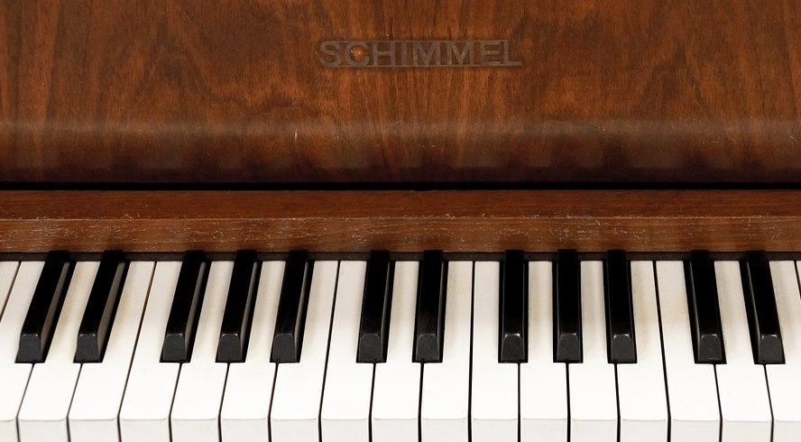
Look at the pattern of black keys. What comes next?
Introduction
?
Which part is repeated? How many times is it repeated?
Notes:
Image source: https://pixabay.com/photos/piano-keyboard-keys-music-849726/

Slide 5
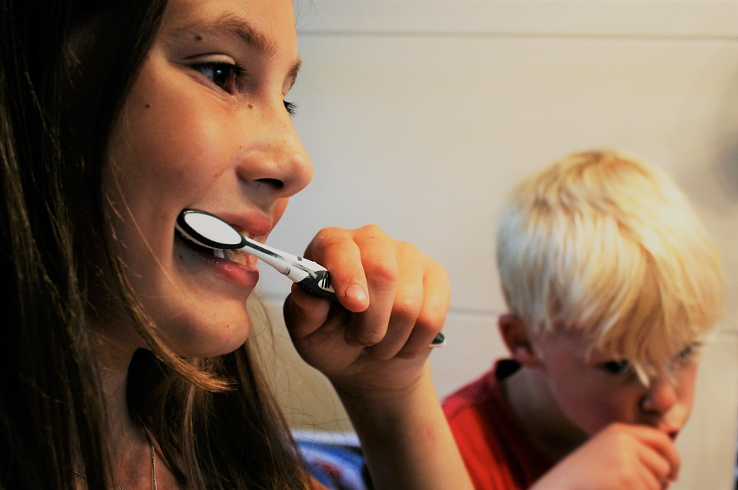
What is being repeated in this action?
Activity 1
Notes:
Give pupils a few minutes to think about actions involved in brushing teeth.
Image source: https://pixabay.com/photos/brushing-teeth-tooth-zahnarztpraxis-2103219/

Slide 6
Instructions for how to brush our teeth
Activity 1
Put toothpaste on toothbrush
Put toothbrush in mouth
Notes:
Continue to write the algorithm, and as you come to the first brushing step, eg ‘Brush front teeth up and down’, ask pupils how many times they do this. Using their response, eg 10, begin to write the step out 10 times. After writing it a few times, ask them if there might be a better way of showing that an action is repeated a number of times.
Discuss responses and choose a suitable one (eg ‘Brush front teeth up and down ×10’) to use in the algorithm.

Slide 7
Instructions for how to brush our teeth
Activity 1
Put toothpaste on toothbrush
Put toothbrush in mouth
Brush front teeth up and down ×10
Brush left lower side forwards and backwards ×20
Brush left upper side forwards and backwards ×20
Brush right lower side forwards and backwards ×20
Brush right upper side forwards and backwards ×20
Rinse mouth

Slide 8
Repeating patterns
Activity 1
Identify the patterns on your activity sheet. Put brackets around the part that is repeated and continue the patterns. The first one has been done for you.
2 4 6 8 2 4 6 8 2 4 6 8 _ _ _ _
(2 4 6 8)(2 4 6 8)(2 4 6 8)(2 4 6 8)
How many times is it repeated in total?
Notes:
Click the slide to reveal the next part of the sequence. It is repeated four times in total.

Slide 9
What does ‘repeat’ mean?
Activity 1
Define the term ‘repeat’, based on the activity that you have just completed.
Think, write, pair, share.
Repeat means ‘to do or say something again’.
Notes:
Definition source: https://www.dictionary.com/browse/repeat

Slide 10
Writing algorithms for squares as a list
Activity 2
Go forward 100
Turn right 90°
Go forward ___
Notes:
Demonstrate writing the algorithm as a list of instructions, in a similar way to the algorithm for brushing teeth from the ‘Repeating patterns’ activity. It has been started for you. Add a couple more steps so that pupils who choose this method can work out the rest for themselves.

Slide 11
Writing algorithms for squares
Activity 2
Write your algorithm on your activity sheet. Decide whether to annotate the diagram or write the algorithm as a list under the shape.
Mark the start position and direction.
Include the directions and their lengths, and any turns and degrees needed.
Number the instructions.

Slide 12
Programming in Logo to draw a square
Activity 2
Use your algorithm to program a square in Logo. The commands below might be useful.
FD XX — Forward XX
BK XX — Back XX
RT 90 — Right 90 (turns right 90°)
LT 90 — Left 90 (turns left 90°)
CS — Clear screen
Clear screen

Slide 13
Using the repeat command in a count-controlled loop
Activity 3
Our commands for a square looked like this:
FD 100 RT 90
FD 100 RT 90
FD 100 RT 90
FD 100 RT 90
What is repeated in these commands, and how many times is it repeated?
Notes:
Click the slide to make the text appear.

Slide 14
Writing it as an algorithm
Activity 3
If we write it as an algorithm, the instructions to be repeated go below the repeat instruction, like this:
This makes a square:
Repeat 4 times
Draw a side 100
Turn 90 degrees
We show the commands that need to be repeated by moving them to the right slightly (indenting).
Notes:
Click the slide to make the text appear.

Slide 15
Using the repeat command in a count-controlled loop
Activity 3
REPEAT 4 [FD 100 RT 90]
Command
How many times to repeat
What to repeat
In square brackets [ ]
Notes:
Click the slide to make the text appear.

Slide 16
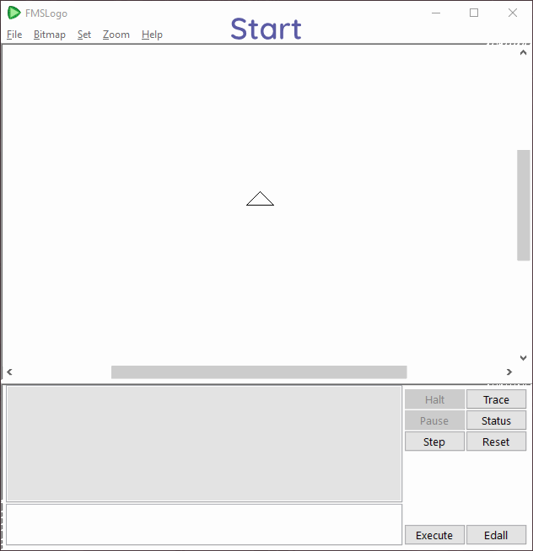
Using the repeat command
Activity 3
Notes:
Play the animation to show how to create a square using the repeat command.

Slide 17
Using the repeat command
Activity 3
Try using the REPEAT command below to program a square.
REPEAT 4 [FD 100 RT 90]
Investigate which of the 3 values (in bold) in this code snippet you can change, whilst still drawing a square.
Tip: Change one value at a time to see what effect it has on the turtle drawing.

Slide 18
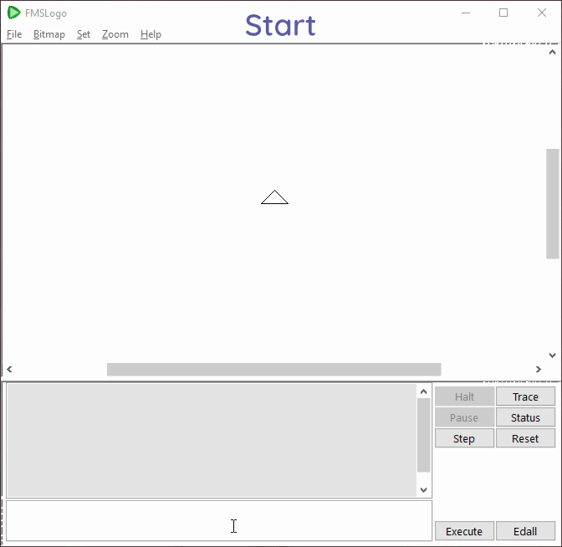
Creating smaller or larger squares
Activity 3
Which value changed the size of the square drawn?
REPEAT 4 [FD 100 RT 90]
Notes:
Play the animation to show how to change the size of the square.

Slide 19
Repetition
Plenary
Look at these commands:
FD 200 LT 90
FD 200 LT 90
FD 200 LT 90
FD 200 LT 90
On your whiteboard, write them using a repeat loop
Hint: Use repeat X [...................]

Slide 20
Repetition
Plenary
Long code snippet
FD 200 LT 90
FD 200 LT 90
FD 200 LT 90
FD 200 LT 90
Code using a repeat loop
Repeat 4 [FD 200 LT 90]
Notes:
Answer: repeat 4 [FD 200 LT 90]

Slide 21
Assessment
How confident are you? (1–3)
I can identify everyday tasks that include repetition as part of a sequence
I can identify patterns in a sequence
I can use a count-controlled loop to produce a given outcome
3 – Very confident
2 – Unsure
1 – Not confident
Notes:
Image source: https://pixabay.com/vectors/thumb-up-hand-like-confirm-go-top-307176

Slide 22
Next lesson
Summary
In this lesson, you…
Looked at patterns all around us in real life
Wrote algorithms to create a square and looked at which parts were repeated
Learnt how to use the repeat command in a count-controlled loop to program a square
Next lesson, you will…
Use count-controlled loops to create other shapes

